Slide 1
How To Get Published
An Introduction to Scholarly Publishing
Ingrid van de Stadt
Regional Marketing Director
EMEA & Latin America
Elsevier
i.stadt@elsevier.com
Notes:
What it means to publish in Int’l journals and I’ll go through some best practices for when you want to publish your research in such journals.

Slide 2




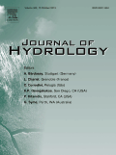
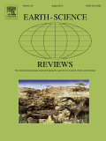


What will we cover in this workshop?
Understanding scholarly publishing
How to get published
How to structure your article
How not to Publish - publishing ethics
Document management: Mendeley
Afternoon:
Peer Reveiw
Notes:
Mendeley: document management and collaboration tool.

Slide 3
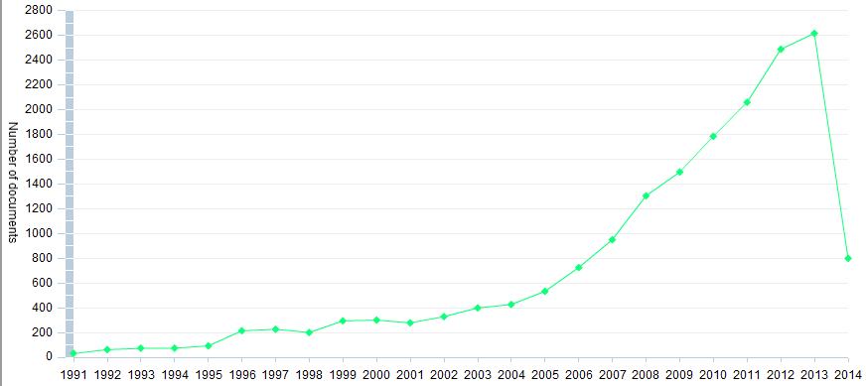
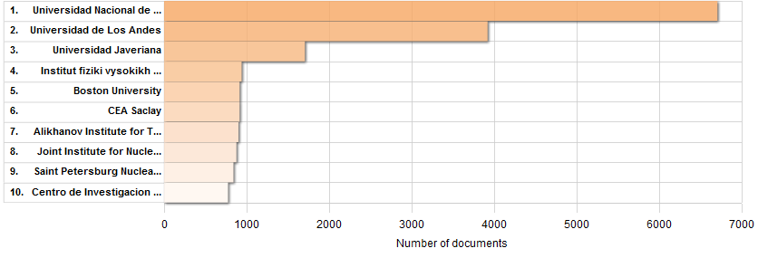
Universities & Research Institutes Bogota Article output
Notes:
SD, Scopus, Scival & eBooks

Slide 4
Role of Scientific Publications
The timestamp to officially note who submitted scientific results first
Registration
Perform peer-review to ensure the validity and integrity of submissions
Certification
Dissemination
Provide a medium for discoveries and findings to be shared
Preserving the minutes and record of science for posterity
Preservation
Publishers are investing in innovation and technology to fulfil these roles
Notes:
Registration: registering the person and time of a scientific work
Certification: Publisher manages the peer-review process
Dissemination: promoting and facilitating the “Use” of scholarly information
Publishers are investing in innovation and technology to find new methods to carry out these roles. They develop products and services to facilitate the exchange of ideas, not only between authors, editors and reviewers, but also with the wider STM audience of researchers, health professionals, students, and patients

Slide 5


The Publishing Cycle
Solicit & manage submissions
30-60% rejected by > 7,000 editors
Archive & promote use
11 million articles in archive
Manage peer review
500,000+ reviewers
>480 million downloads by >30 million researchers in >180 countries!
Publish & disseminate
Edit &
prepare
Nearly ½ million articles accepted
9.8 million articles available
Production
Notes:
“produced” means: typeset, posted online, linked to the various external platforms like PubMed, promoted to the appropriate audience and of course archived for future use.

Slide 6

The Digital Age of Publishing
Solicit and manage submissions
Author submission & Editorial systems
Mobile content
Archive and promote use
Manage Peer Review
Electronic platforms
Publish and Disseminate
Edit and Prepare
eJournal Backfiles
eReference Works
Electronic warehousing
Production
Production tracking systems
Notes:
But what value do Publishers add to the publishing process? In the digital age, how have we invested in tools and services to support these different steps of the Publishing cycle.

Slide 7
Global Expansion of Scientific Research
Notes:
Due to investment by publishers and librarians, access to research in developing countries has grown, resulting in increased article output and the emergence of a global research network.
Improved access to research have enabled developing countries to become larger players in the research community.
As you can see here, some of the fastest growing countries in terms of research output are in developing areas.

Slide 8
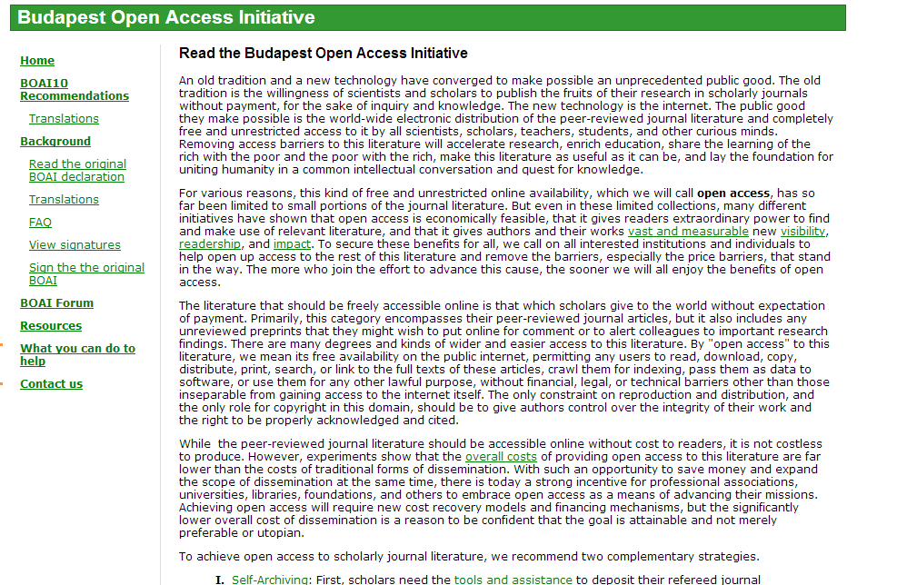
What is Open Access Publishing?
The History
Free availability on the public internet
Permitting users to read, download, copy, distribute, print, search, or link to the full texts of these articles
Crawl them for indexing
Licenses to allow use and re-use without financial, legal, or technical barriers
Accessible online without cost to readers, but not costless to produce. So, funding needed by authors, institutions, funders or others

Slide 9




Publishing with Open Access
Elsevier’s open access publication fees are market based & provide competitive prices which range from 500-5000 USD.
Offer authors a choice of user licenses, including Creative Commons.
Developed a number of institutional and funding body agreements to help streamline processes and manage open access policies.
For more Open Access information:
http://www.elsevier.com/about/open-access/open-access-options
Notes:
Elsevier published 60 OA journals and adding new ones on a continuous basis
OA articles: Subscription journal which offers an open access option. Open Access articles are freely available to subscribers and the general public with permitted re-use. Elsevier offers this choice in 1600 established peer reviewed journals.
Open Archive: Articles which are made open access after an embargo period. These articles are freely available to subscribers and the general public with permitted re-use.
Length of embargo period is journal specific
Provides free access to archived material
Elsevier has 82 journals that feature Open Archives
Green OA: pre-prints & accepted manuscripts in IR’s

Slide 10
Green Open Access
What Are They?
Publication costs are paid for by subscriptions, which enable readers to access the final published version of the article
Elsevier Policy:
Authors can voluntarily self-archive preprints and accepted manuscripts to institutional repositories and websites
Where funders and institutions mandate manuscript posting, we seek agreements
These require journal-specific embargo periods - typically 12-24 months
Elsevier is recognised as a Green publisher in the Sherpa/ROMEO database
Notes:
When we look at Green Open Access and self archiving more broadly- Elsevier also supports this route- however, the costs for publication via the green route are covered by subscriptions.
As such we need to ensure green open access policies are sustainable for our journals.
We permit voluntarily posting of accepted author manuscripts to institutional repositories and websites
When your institution has a policy which systematically organizes posting- Elsevier requires an agreement. This is more like a letter of intent which says your institution will respect our journal specific embargo periods.
Our embargo periods are typically 12-24 months and a full list is available online ( go to www.elsevier.com/openaccess)
Our policy is quite open- the Sherpa/Romeo database which helps authors and institutions find out information about copyright and policies of publishers and journals- lists us as a green publisher.

Slide 11

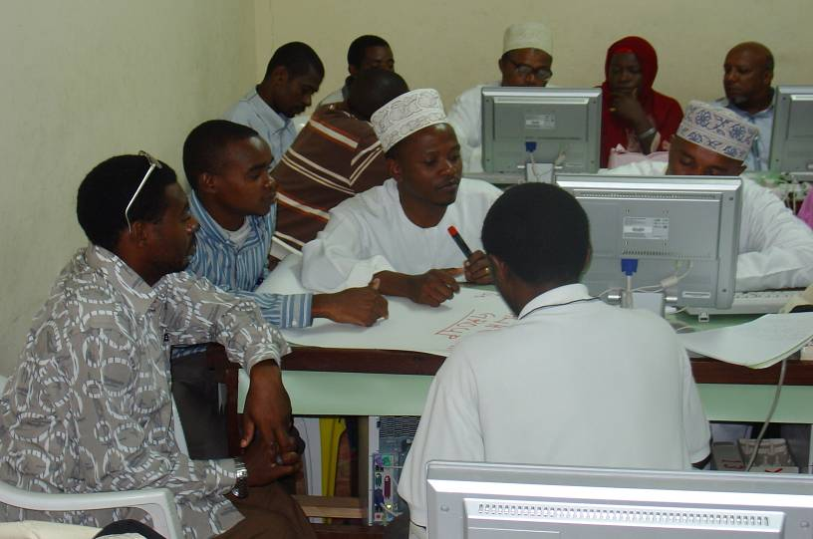


Information Philanthropy
Publishers provide free or low cost access to thousands of peer-reviewed journals to public institutions in over 100 developing countries
Notes:
partnering with UN agencies

Slide 12
What Makes A Strong Manuscript?
Clear & useful message
A logical manner
Readers grasp
the research

Slide 13
Are You Ready To Publish?
Re-interpretation of results
Outdated work
Review
New + original results
Duplication
Notes:
You SHOULD NOT consider publishing yet if:
Your report lacks scientific interest or does not substantially advance the field
The work is outdated
You would be duplicating previously published work
Your conclusions are incorrect/not acceptable
A strong manuscript and message is crucial in order to present your contributions to the scientific community.

Slide 14
Types Of Manuscripts
Full articles
Letters or short communications
Review papers

Slide 15
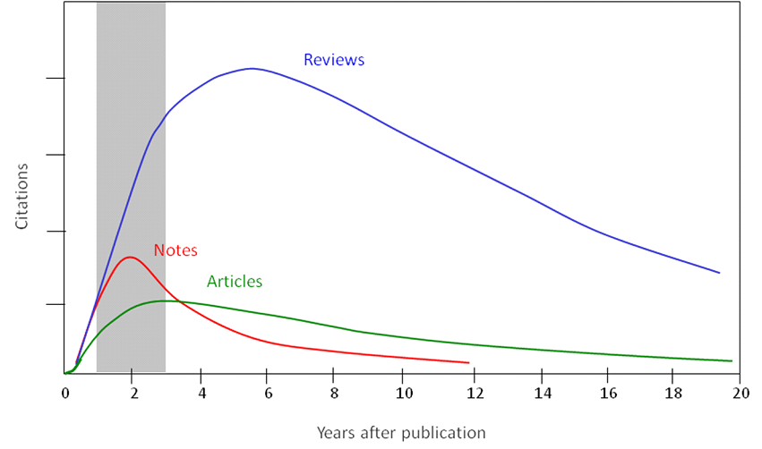
Citations per Article Type

Slide 16
Your paper is worthless if no one reads, uses, or cites it
A research study is meaningful only if...
It’s clearly described, so
Someone else can use it in his/her studies
It arouses other scientists’ interest, and
Allows others to reproduce the results
By submitting a manuscript you are basically trying to sell your work to your community

Slide 17




Practical Advice
Evaluate your research area
http://top25.sciencedirect.com/
Journals, authors, citations, publications per year (Scopus)
Evaluate which journal is right for your article
Impact Factor
Alternative metrics (H-index, SNIP, SCImago)
Journal Analyzer (Scopus)
Find out more about the journals
Who are the editors?
Guide for authors
Getting your paper noticed
Cite Alert
Article Usage Alert
IF

Slide 18
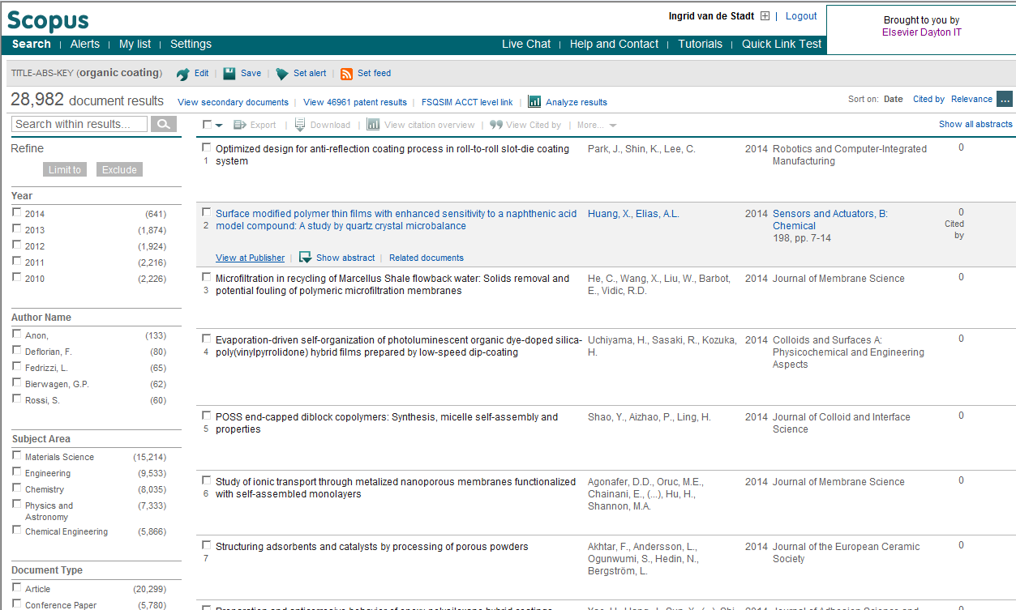
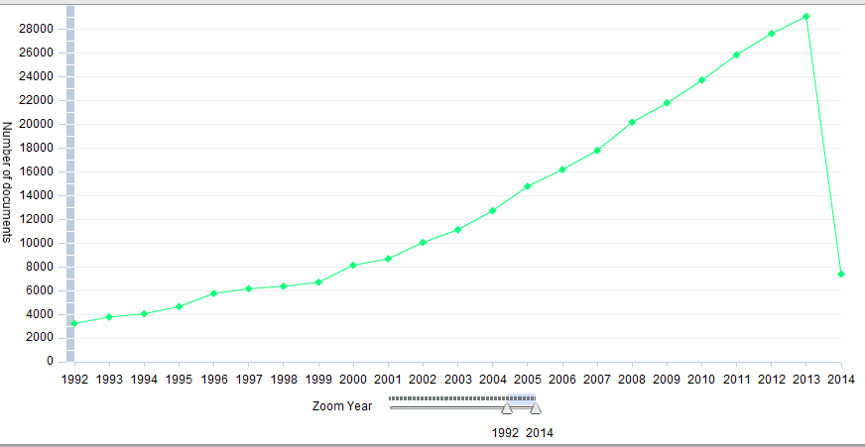
Review the development of your research area
Check the phase in the life-cycle of your research topic.
N.B. Decline may be caused by backlog in publication

Slide 19
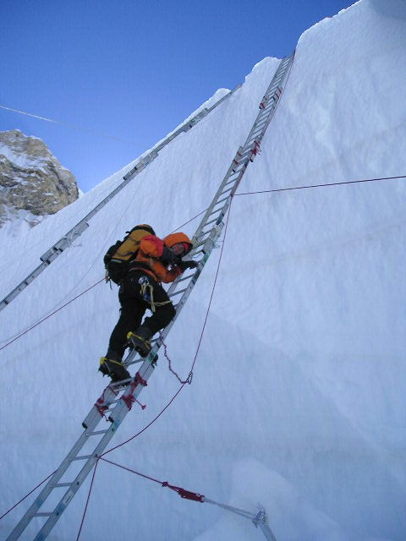
Choose the right journal
Do not just “descend the stairs”
Top journals
Nature, Science, Lancet, NEJM
Field-specific top journals
Other field-specific journals
National journals
DO NOT gamble by submitting your manuscript to more than one journal at a time.
International ethics standards prohibit multiple/simultaneous submissions, and editors DO find out!

Slide 20

Article Transfer Service
Editors may transfer sound submissions to another Elsevier journal
Provided the submission is of high-quality and rejected because it doesn’t fit the Aims & Scope of the journal
Notes:
So taking a look now at a couple of recent developments in the Publication Process:
Article Transfer Service:
A large number of submissions with high-quality scientific content are rejected by journal editors because the paper does not fit the aims and scope of the journal. However, if the paper is scientifically sound then the author needs to begin the submission process with another journal. We understand this is a time consuming and often frustrating process. (Equally these are lost opportunities for publishers like Elsevier).
The Article Transfer Service attempts to retain appropriate content by allowing editors who deem articles to be of sufficient quality, but unsuitable for their specific journal, to transfer those submissions to another Elsevier journal with agreement from the author. This means that the paper does not begin the entire process once again from the start, but is kept within the submission process and can flow through to a more appropriate journal quicker.

Slide 21
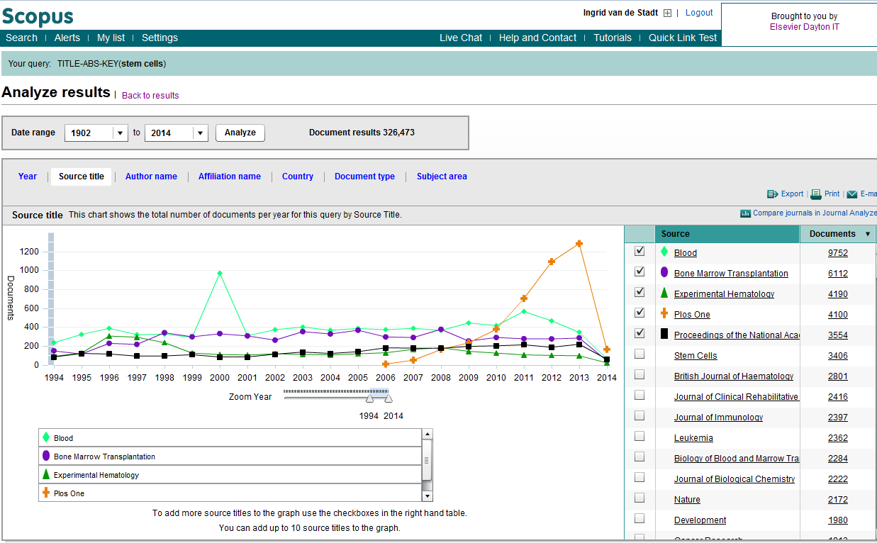
Choose a target journal
Use your own references
Check databases to find in what journals most articles on your topic were published

Slide 22
Is this a prestigious journal?
Impact Factor
Eigenfactor
SJR
SNIP
H-Index
Types of Indicators

Slide 23
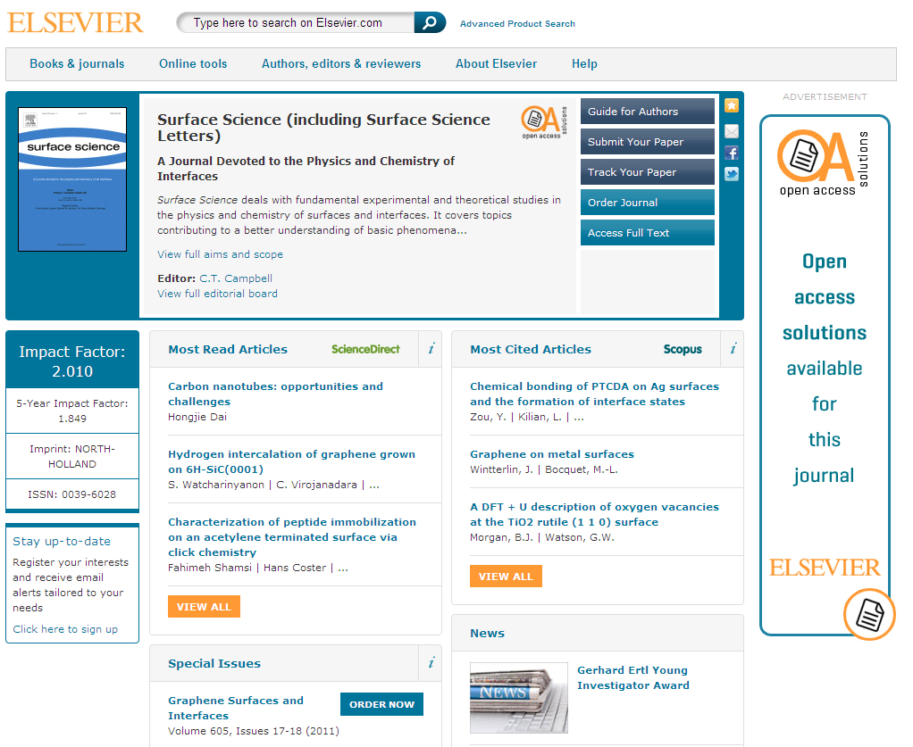
Choosing The Right Journal
Visit e.g. elsevier.com to find:
Aims & Scope
Accepted types of articles
Readership
Current hot topics
Ask for help from your supervisor or colleagues
DO NOT submit manuscripts to more than one journal at a time

Slide 24
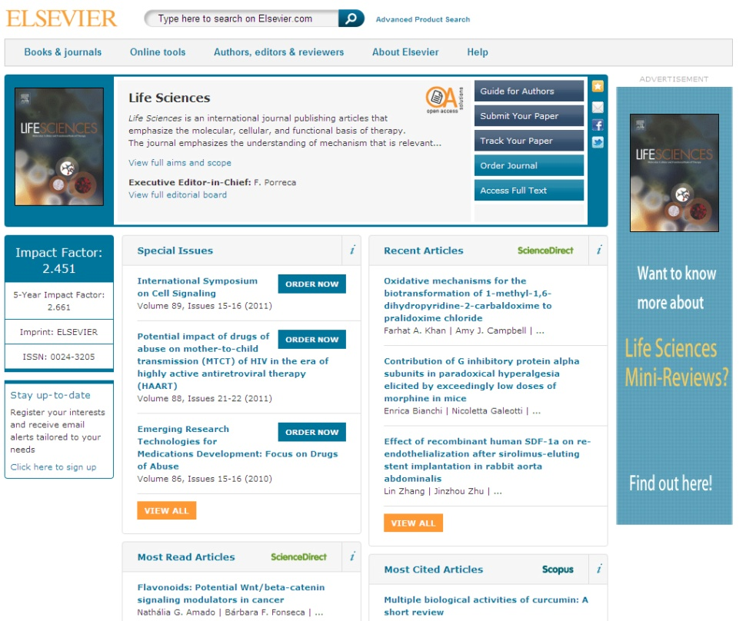
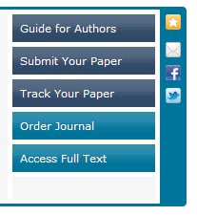
Read The ‘Guide for Authors’
Find it on the journal homepage of the publisher, e.g. Elsevier.com
Keep to the Guide for Authors in your manuscript
Editors do not like wasting time on poorly prepared manuscripts

Slide 25
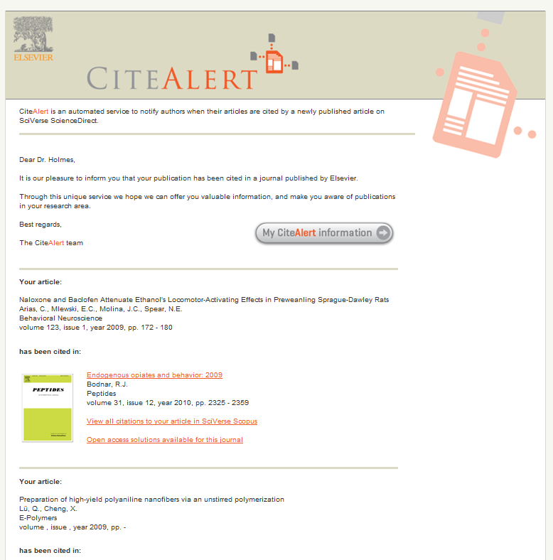
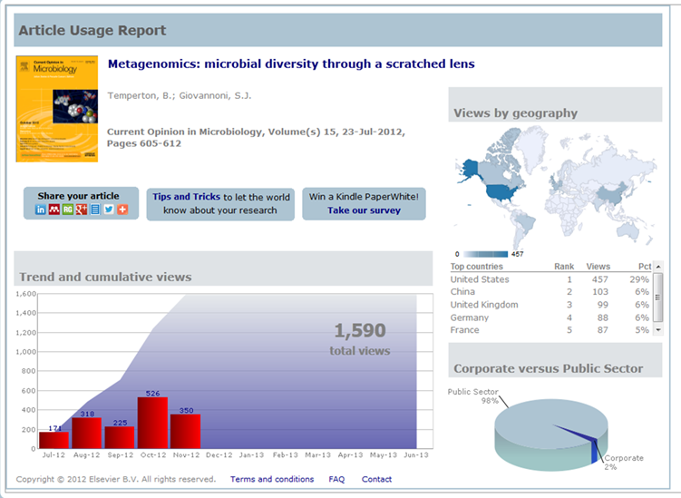
Getting your paper noticed
Cite Alerts
Weekly notification to authors once their article is referenced in a newly published article.
Usage Alerts
Quarterly e-mail to authors, with a link towards a customized web page per article
Notes:
Citation Alerts: helps authors to keep track of citations. Weekly service. Elsevier-published journals only. Unique to Elsevier.
Usage alert: Look into how the article is being downloaded by users. Quarterly email to corresponding authors linking to a dashboard of ScienceDirect usage data for the first year after publication of their article. We have this for many journals, but not all yet. Easy sharing options for promoting your article to peers via social media

Slide 26
Do publishers correct language?
No! It is the Author’s responsibility...
...but resources are available
http://webshop.elsevier.com
26

Slide 27

‘How To Get Published’
Structuring An Article
September 2013
Notes:
The goal of this presentation is to provide advice about how to properly structure your article.

Slide 28
General structure of a research article
Title Abstract Keywords
Make them easy for indexing and searching Informative, attractive, effective
Introduction Methods Results and Discussion
Conclusion
Acknowledgements
References
Supporting Materials
Convey the main messages and findings effectively
Make it as concise as possible
Order can change
Notes:
Manuscripts contain many sections and each one has a definite purpose.
At the beginning are the Title, Abstract, and Keywords which all play important roles in allowing the article to be easily found, easily indexed, and advertised to potential readers. Make them easy for indexing and searching (informative, attractive, effective).
2. The main text of the article is summarized by the IMRAD acronym: Introduction, Methods, Results, AND Discussion. This is where you must present your work and convey the main messages and findings effectively. Reader’s time is not unlimited. Make your article as concise as possible.
3. The last group of sections bring up the end of the manuscript. The Conclusion, Acknowledgements, References and Supporting Materials. But these are just artificial groupings and the order can change. Some journals request the Discussion section to be combined with the Conclusion or Results. Others need it to be an independent section. There are also different arrangements of the order (e.g., Methods put after R & D…). Read the Guide for Authors for the specific criteria of your target journal.

Slide 29
Authorship
Corresponding Author
First Author
Good Listing Principle
Ghost Authorship
Gift Authorship
Poor Listing Principle
Conducts or supervises the data collection, analysis, presentation and interpretation of the results
Puts together the paper for submission
Notes:
Determining the order of authors on a paper can vary by discipline and culture, but the general rule is that the first author is the person who conducts or supervises the data collection, analysis, presentation and interpretation of the results, and also puts together the paper for submission. The corresponding author can be the first author, or sometimes is a senior author from the institution.
You should always avoid ghost authorship, which means excluding authors who participated in the work, and gift authorship, which means including authors who did not contribute to the work. Be consistent in how you write the authors names.

Slide 30
Titles: attract the attention
Fewest possible words
Adequately describes content
Identifies main issue
Does not use rarely-used abbreviations or technical jargon
Effective manuscript titles
Notes:
There are certain characteristics of effective titles. They should:
Attract the reader’s attention
Contain the fewest possible words
Be specific and directly reflect the content of your manuscript
Be informative but concise
And they should not include technical jargon and abbreviations; use formal language
It is advisable to discuss the title with your co-authors.
Remember: Editors and reviewers don’t like titles that make no sense or fail to represent the subject matter adequately. And maybe even more important, you want the appropriate audience to read your paper. If the title isn’t accurate, the right people may not read it and the community might be unaware of your work. This could even lead to lower citations than the paper deserves. Do not contain rarely-used abbreviations.

Slide 31
Keywords
Are used by indexing and abstracting services
Are the labels of the manuscript; avoid words with broad meanings.
Use only established abbreviations (e.g. DNA)
Article Title
Keywords
“An experimental study on evacuated tube solar collector using supercritical CO2”
Solar collector
Supercritical CO2
Solar energy; solar thermal utilization
Check guide for authors !
Notes:
Keywords are the labels or tags for your manuscript. Avoid words that have broad meaning - These should be specific enough to give someone a very quick idea about the content of your paper and are used by indexing and abstracting services.
Only use abbreviations that are firmly established in the field of study, e.g. DNA.
Check the Guide for Authors for specifics on which keywords should be used.
The green box contains actual examples of keywords that are associated with two articles taken from ScienceDirect.

Slide 32
Abstract the advertisement of your article
Make it interesting and understandable
Freely available on Pubmed, Scopus etc...
Make it accurate and specific
Summarize problem, method, result & conclusion
A clear abstract will strongly influence whether or not your work is considered
Keep it brief and catchy
Tip: write your Abstract last
Notes:
If the title catches a reader’s attention, the next thing they check is the abstract.
It is freely available in electronic abstracting & indexing services [PubMed, Medline, Embase, Scopus, ....]
This should be a single paragraph summarising the problem, the method, the results, and the conclusions.
The abstract acts as an advertisement for your article since it is freely available via online searching and indexing. You want to make it as catchy and accurate as possible to have the greatest impact.
An abstract written clearly will strongly encourage the reader to read the rest of your paper.
Many authors write the abstract last so that it accurately reflects the content of the paper. Take the time to write this very carefully.

Slide 33
The Process of Writing – Building the Article
Title & Abstract
Conclusion
Introduction
Methods
Results
Discussion
Figures/Tables (your data)
Notes:
The sequence of writing the article is not the same as reading it. For most scientific fields, the most efficient way is to regard the manuscript as a wall, building it brick by brick. You start with producing your tables and figures, with captions/legends.
Then describe the Method used, then the Results found and the Discussion around these results.
The Conclusion should flow on from this fairly easily.
Then you write the Introduction, as to where your work fits into the field as a whole.
Finally, the Title, Abstract and Keywords.
This process of building the article is easier, more logical and more effective that trying to write an article in the sequence it is read.

Slide 34
Introduction
Provide a brief context to the readers,
but not a history lesson
Introduce the main scientific publications
Address the problem
Identify the solutions & limitations
What is hoped to be achieved
Provide perspective consistent with the nature of the journal
Notes:
The Introduction is used to provide context for your manuscript and convince readers why your work advances a field of study.
Be concise in the introduction but give the reader enough information to understand why the work is important. Introductions of Letters can be shorter, sometimes only one paragraph. This section shouldn’t be a history lesson but you do need to introduce the main scientific publications on which your work is based. Cite a couple of original and important works, including recent review articles, to give the reader a sense of how your work fits into the literature. But, take care to not make citations to irrelevant references, including your own.
Make sure you clearly address the following: what is the problem you are ultimately trying to solve? Are there any solutions? If so, what is the best solution and what is it’s limitations? What is your work trying to achieve?
Provide a perspective that is consistent with the journal where you are submitting.
Though it can be tempting to re-use introductions from your previous papers on similar studies, every paper should present a new result and the work should be specifically motivated. This requires a unique introduction every time.

Slide 35

Methods
Describe how the problem was studied
Include detailed information
Do not describe previously published procedures
Identify the equipment and describe materials used
Notes:
The Methods section describes how you studied the problem.
It is important to be detailed - a knowledgeable reader should be able to reproduce the experiment.
Any previously published procedures should not be re-written in detail. Those can be noted in the References or described in the Supporting Materials sections.
Identify the equipment and materials used in experiments, along with their sources if there is the chance for variability of quality of these items. If the work is computational or theoretical, here you can describe code, computational, or analytical methods.

Slide 36

Results
Be clear & easy to understand
Highlight the main findings, essential to the discussion
Feature and explain unexpected findings
Provide statistical analysis
Include illustrations & figures
Notes:
Moving on to the results section. This is where you describe the important results of your research.
You should present the results that are essential to the discussion which means that only data of primary importance should be shared. Data of secondary importance should be put in the Supporting or Supplementary Materials section.
But do not attempt to “hide” data in the hope of saving it for a later paper, or split the results of one project into many papers. This dilutes the effect of the work, results in lower quality papers and you may lose evidence that re-enforces your conclusions.
2. Use sub-headings to keep results of the same type together – this will make it easier to review and read. Number these sub-sections for the convenience of internal cross-referencing. Decide on a logical order of the data that tells a clear story.
Highlight findings which further understanding in the field, or those that differ from previous findings and explain any unexpected results.
Illustrations, including figures and tables, are the most efficient way to present the results. Your data are the “driving force of the paper”. Therefore, your figures and illustrations are critical and they should be used for ESSENTIAL data only. The legend of a figure should be brief and it should contain sufficient explanatory details to explain the figure without the need to refer to the text. Use color ONLY when necessary. If different line styles can clarify the meaning, don’t use colors or other thrilling effects which can distract from the content and may not appear when printed in black and white.
A. Graphs are often used to compare experimental results with those of previous works, or with calculated/theoretical values. Graphs should not appear crowded; try to present at most 3 to 4 data sets per figure. Use well-selected scales, label the axes clearly, use different symbols so that one can quickly discriminate between the data sets.
B. Often times tables give the actual experimental results. Do not include long boring tables unless absolutely necessary (otherwise put them in the supplementary material), and make them as easy to read as possible.
C. Every photograph or image should be presented with a scale marker and the resolution should be clear.

Slide 37

Discussion
What do the results mean?
Most important section
Sell your article!
Make the discussion correspond to the results and the introduction
You need to compare published results with your own
Notes:
The Discussion is where you interpret what your results mean.
1. This is the most important section of the article. This is where you get the chance to SELL your data! A huge number of manuscripts are rejected because the Discussion is weak or only includes mere description of the results.
2. Make sure the Discussion corresponds to and compliments the Results, But do not simply repeat the results here.
3. Compare other published results with your own, And DO NOT ignore work in disagreement with yours – confront it and convince the reader that you are correct or better.
Be careful not to use the following:
- Statements that go beyond what the results can support
- Non-specific expressions such as “higher temperature” or “at a lower rate”; use quantitative descriptions instead
- The introduction of new terms not already defined or mentioned in your paper
- Speculations on possible interpretations are allowed. But these should be carefully explained and rooted in fact, rather than imagination.
If you need to revise the Results or Discussion this may involve a lot of work and require further experiments, derivations, or simulations. Sometimes you may not be able to clarify your idea just in words because some critical items have not been studied substantially – make sure your message is complete before you start writing or submit.

Slide 38
The Conclusion
Not a repetition of the Abstract
Provide suggested future experiments
Should be clear, about the impact of your work
Advance the present state of knowledge
Notes:
The Conclusion is used to show how your work advances the field of study.
1. The conclusion should be clear to help the reviewers and editors judge your work and its impact.
2. Provide clear justification for how your work advances the field. This can be achieved by indicating uses, extensions, or applications of the work. Do not just repeat the abstract here. The Abstract and Conclusion serve different purposes although some of the same messages may be mentioned. Also, don’t list the experimental results here – trivial restatements of your results are unacceptable in this section.
3. Suggest future experiments that build on your work and point out any relevant experiments that may already be underway.

Slide 39
Acknowledgments
Advisors
Financial Supporters & Funders
Proofreaders & Typists
Suppliers who may have donated materials
In a single, brief paragraph
Notes:
The acknowledgments section is where you mention those who helped in the research but are not authors. This should be a single brief paragraph. Most often mentioned here are:
Advisors
Financial supporters/funders
Proofreaders
Typists
Suppliers who may have donated materials.

Slide 40

References
Do not use too many references
Always ensure you have fully absorbed material you are referencing
Avoid excessive self-citations
Avoid excessive citations of publications from the same region
Conform strictly to the style given in the guide for authors
Notes:
The reference list is where you cite the main scientific publications on which you based your work. Take note that there are now some society journals that also require a “Conflict of Interest” statement to be placed before the References section.
Some tips for having a proper reference list are:
Do not include too many references, especially if they are only tangentially related to your work.
Always ensure that you have fully absorbed and understood the material you are referencing and do not just rely on reading excerpts or isolated sentences. Know what you’re referencing!
Avoid excessive self-citations of your own work or from a single region or institute.
4. Check the Guide for Authors to ensure the proper format. Presentation in the correct format is the responsibility of the author, not the Editor. Make the Editor’s work easier and they will appreciate the effort.

Slide 41
How not to Publish Publishing Ethics

Slide 42
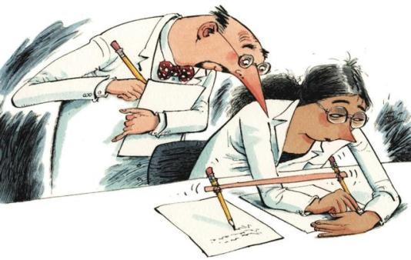
Publish AND Perish! – if you break ethical rules
International scientific ethics have evolved over centuries and are commonly held throughout the world.
Scientific ethics are not considered to have national variants or characteristics – there is a single ethical standard for science.
Ethics problems with scientific articles are on the rise globally.
M. Errami & H. Garner, A tale of two citations
Nature 451 (2008): 397-399

Slide 43
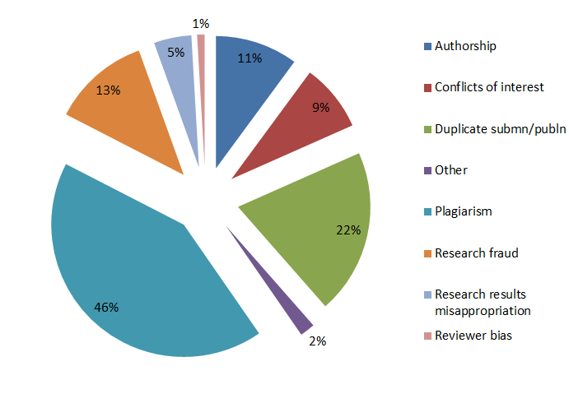
Plagiarism high amongst ethics issues
Sample of cases reported to Elsevier Journals publishing staff in 2012

Slide 44
What is Plagiarism?
“Plagiarism is the appropriation of another person’s ideas, processes, results, or words without giving appropriate credit, including those obtained through confidential review of others’ research proposals and manuscripts.” Federal Office of Science and Technology Policy, 1999
“Presenting the data or interpretations
of others without crediting them, and
thereby gaining for yourself the
rewards earned by others, is theft,
and it eliminates the motivation of
working scientists to generate new
data and interpretations.” Professor Bruce Railsback Department of Geology, University of Georgia
M. Errami & H. Garner, A tale of two citations
Nature 451 (2008): 397-399

Slide 45
What may be Plagiarised?
Work that can be plagiarised includes…
Words (Language)
Ideas
Findings
Writings
Graphic Representations
Computer Programs
Diagrams
Graphs Illustrations Information Lectures Printed Material Electronic Material Any Other Original Work
Higher Education Academy, UK

Slide 46
Correct Citation is Key
Crediting the work of others (including your advisor’s or your own previous work) by citation is important for at least three reasons:
To place your own work in context
To acknowledge the findings of others on which you have built your research
To maintain the credibility and accuracy of the scientific literature

Slide 47
Paraphrasing
Paraphrasing is restating someone else's ideas while not copying their actual words verbatim
Unacceptable:
Using exact phrases from the original source without enclosing them in quotation marks
Emulating sentence structure even when using different words
Emulating paragraph organization even when using different wording or sentence structure
– Statement on Plagiarism
Department of Biology, Davidson College.
http://www.bio.davidson.edu/dept/plagiarism.html

Slide 48
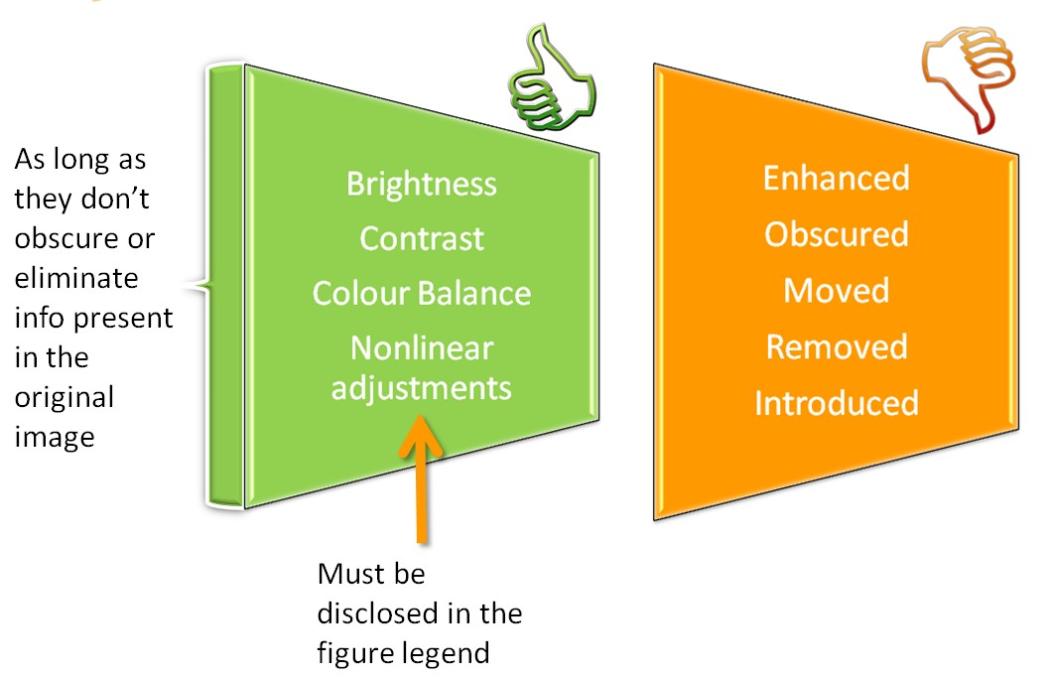
Figure Manipulation

Slide 49

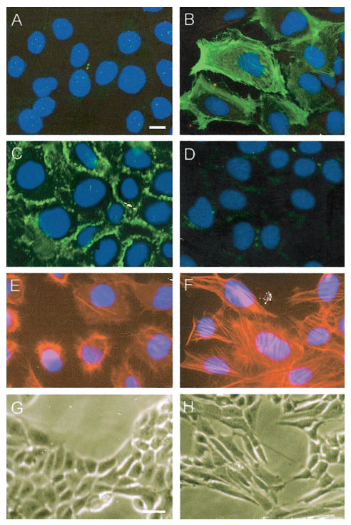
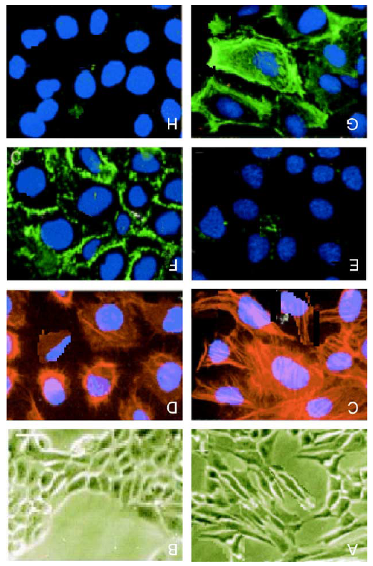
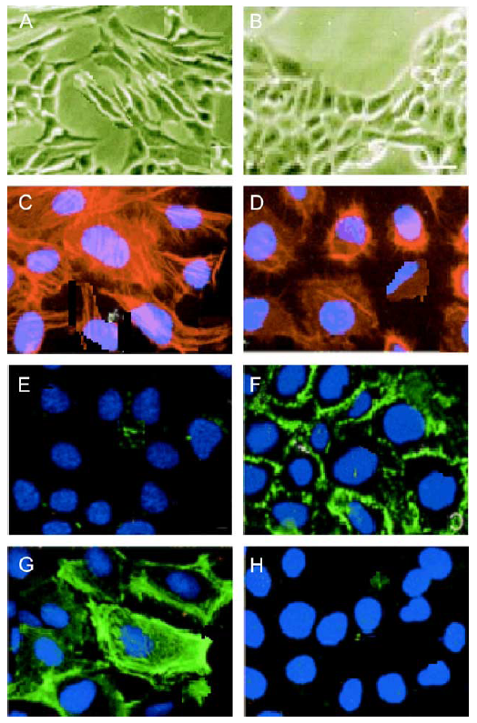
Figure Manipulation Example - Diffferent authors and reported experiments
Am J Pathol, 2001
Life Sci, 2004
Life Sci, 2004
Rotated 180º
Rotated 180º

Slide 50

Plagiarism Detection
Cross Check Initiative (2009)
Huge database of 30+ million articles, from 50,000+ journals, from 400+ publishers
Software alerts Editors to any similarities between the article and this huge database of published articles
Many Elsevier journals now check every submitted article using CrossCheck

Slide 51
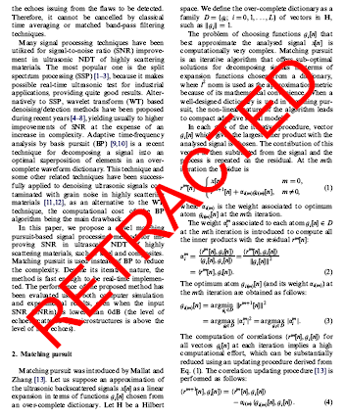

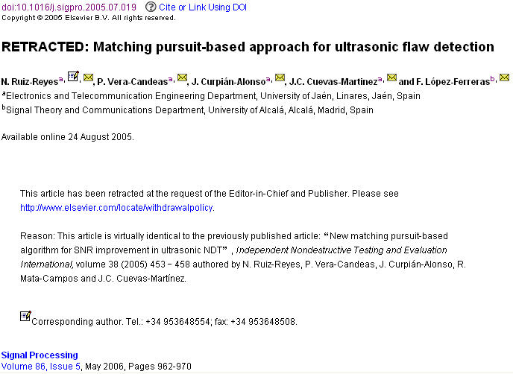
The article of which the authors committed plagiarism: it won’t be removed from ScienceDirect. Everybody who downloads it will see the reason of retraction…

Slide 52
‘How To Get Published’
Reviewing

Slide 53

Principles of Peer Review
A well understood concept, based on impartiality, transparency and confidentiality
Without it there is no control in scientific communication
Registering, validating, improving, and preserving research in a fair and unbiased way
Notes:
We will now look at the principles of peer review. Peer review is a widely understood concept in the academic community requiring transparency, impartiality, confidentiality and timeliness. Reviewers make the process work by critically examining and commenting on manuscripts in a fair and unbiased manner. Peer review has been a formal part of scientific communication for over 300 years and without peer review there would be no quality-control in scientific communication. In addition to the formal peer-review process, journal Editors will also evaluate and reject a number of articles prior to external peer review.
Peer review has become the filter that is used to evaluate the quality, comment on validity, judge the significance and determine originality of research.

Slide 54
Purpose of Peer Review
Ensures best quality papers are selected
Improves quality of the published paper
Ensures previous work is acknowledged
Detects plagiarism and fraud
Plays a central role in academic career development

Slide 55
Role of Reviewer and tasks
The peer review process is based on trust
The scientific publishing enterprise depends largely on the quality and integrity of the reviewers
Reviewer should write reports in a collegial and constructive manner
Treat manuscripts in the same manner as if they were your own

Slide 56
Issues to review as Reviewers
Importance and Clarity of Research Hypothesis
Originality of work
Strengths & weaknesses of methodology, approach & interpretation
Writing style and figure/table presentation
Ethics concerns (animal/human)
Notes:
As a reviewer, it’s important to use a systematic approach when reviewing an article. Firstly, look the importance and clarity of the research hypothesis. Does the article provide a context for the testing of the hypothesis? Next, consider the originality of the work. Does the article contribute something new to the literature? If the topic has been covered before, how does this article differ? The next section is the Methodology. The methodology should be fully explained, relevant to the study, and it should be possible to replicate it. A good Discussion section will relate the findings back to the aims of the research as outlined in the Introduction. The author should address the implication of the results presented.
Finally, consider the writing style and presentation of figures and tables. Could the article be better organised, and is the language neutral and suitable for the relevant audience? Are all the tables and figures necessary, and do they add to the quality and depth of the article?
Throughout the review process it is important to consider ethics concerns. Check whether the protocol has been approved by an appropriate Ethics Committee?

Slide 57
Rejection without external review
The Editor-in-chief evaluates submissions and determines whether they enter into the external review process or are rejected
Out of Scope
Poor quality
Inadequate English language
Multiple simultaneous submissions of same data
Prior publication of the data
Notes:
Some articles are rejected without external review. When a manuscript is first submitted to a journal, the Editor-in-Chief carries out an initial evaluation to decide whether or not the article should enter into the external review process. The Editor does this to identify those articles which are either out of scope, of very poor quality, or may have ethics concerns such as multiple submission. Each journal Editor will have his/her own journal-specific rules to identify those articles which should be rejected without external review.

Slide 58
Review Process (I)
Articles are initially reviewed by at least two Reviewers
When invited, the Reviewer receives the abstract of the manuscript
The Editor generally requests that the article be reviewed within 2-4 weeks
Articles are revised until the Reviewers agree, or until the Editor decides that the Reviewer concerns have been adequately addressed
The Reviewers’ reports help the Editors to reach a decision on a submitted paper
Notes:
At the start of the review process, the journal Editor will usually invite two potential reviewers to review the article. The Editor generally requests that the article be reviewed within two weeks, although extensions are sometimes acceptable.
When the reviewers submit their reports and recommendations, the Editor makes a decision and communicates this to the author. The article is then revised until the reviewer comments have been satisfactorily addressed.

Slide 59
Review Process (II)
If a report has not been received after 4 weeks, the editorial office contacts the Reviewer
If there is a notable disagreement between the reports of the Reviewers, a third Reviewer may be consulted
The anonymity of the Reviewers is maintained, unless a Reviewer asks the Editor to have their identity made known
Notes:
If a reviewer does not submit their report within the agreed time limit, the editorial office will contact the reviewer. The timely return of reviews is very important. If you are reviewing a paper please try to return your report speedily. As an author you know how it feels to wait for a decision!
Sometimes the two invited reviewers are unable to agree on a recommendation, and there may be a large disparity in their comments about a particular paper. In this case, a third reviewer may be invited to review the article. The Editor will decide when this is necessary.
In all cases, the reviewers remain anonymous, although if you wish, you can ask to have your identity made known to the author.

Slide 60
Review Process (III)
Reviewers must not communicate directly with Authors
All manuscripts and materials must be treated confidentially by Editors and Reviewers
The aim is to have a first decision to the authors by 4-6 weeks (depending on the field) after submission
Meeting the schedule objectives requires a significant effort by all involved
Reviewers should treat Authors as they themselves would like to be treated
Notes:
Finally, let’s review some of the do’s and don’ts of reviewing. It is crucial that reviewers do not contact authors directly about their paper, and follow the instructions of the journal Editor at all times. All manuscripts and related material you receive as a reviewer must be treated as confidential, and must not be shared with anyone else or used in your own research. When preparing your comments for the author, remember to provide constructive, evidence-based feedback.
Timeliness is key in reviewing. All journals aim to have a first decision to authors as quickly as possible, usually (but not in all fields) within 4-6 weeks. So Your co-operation in meeting that schedule is very important, and greatly appreciated by the entire editorial team. This includes the editorial staff, the Editor and all the reviewers who work very hard to reduce the time that authors - such as you and your colleagues - have to wait for a decision.
The role of a reviewer is a valuable one, and central to the scholarly community. We hope that you will treat the authors of any manuscript you review as you would like to be treated!

Slide 61
What can you get back from peer review?
Accepted without change (very rare!)
Accepted after minor revision (means you will have to change a few things)
Accepted after consideration (means you will have to rewrite a few things, possibly sections, figures, provide more data, etc)
Reconsider after major revision (means you will have to address some fundamental shortcomings – possibly doing additional research and certainly rewriting big sections)
Rejection (means the manuscript is not deemed suitable for publication in that journal)

Slide 62
What leads to acceptance ?
Attention to details
Check and double check your work
Consider the reviewers’ comments
English must be as good as possible
Presentation is important
Take your time with revision
Acknowledge those who have helped you
New, original and previously unpublished
Critically evaluate your own manuscript
Ethical rules must be obeyed
– Nigel John Cook
Editor-in-Chief, Ore Geology Reviews

Slide 63
Thank You
Further reading on plagiarism:
www.ethics.elsevier.com
For writing/submission tips and author services:
www.elsevier.com/authors
Free webcast tutorials on getting published:
www.elsevier.com/trainingwebcasts

